Slide 1

ANALYSIS OF EMPLOYEE ATTRITION
Kristin Henderson
hendersonk@smu.edu
Notes:
Hello, everyone. I'm Kristin Henderson from DDS Analytics.
Today I will present my analysis of your employee attrition data.

Slide 2

Overview
Description of the analysis
Top 3 factors leading to attrition
Attrition classification model
Interactive App
Income regression model
Recommendations
Notes:
First, I’ll take you through a brief description of how I did the analysis.
I’ll go through the top 3 factors leading to attrition
Then I’ll tell you about a predictive model for attrition.
I will give a short demo of an interactive app that allows you visualize some of these trends.
I’ll talk about another model for predicting monthly income.
Finally, I’ll go through some recommendations.

Slide 3
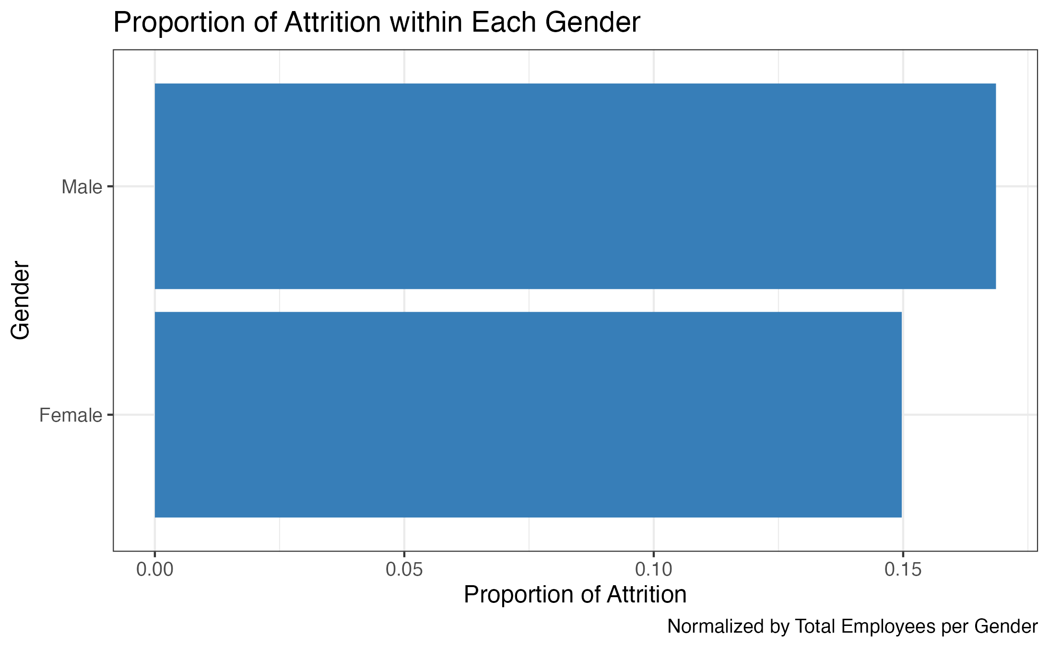
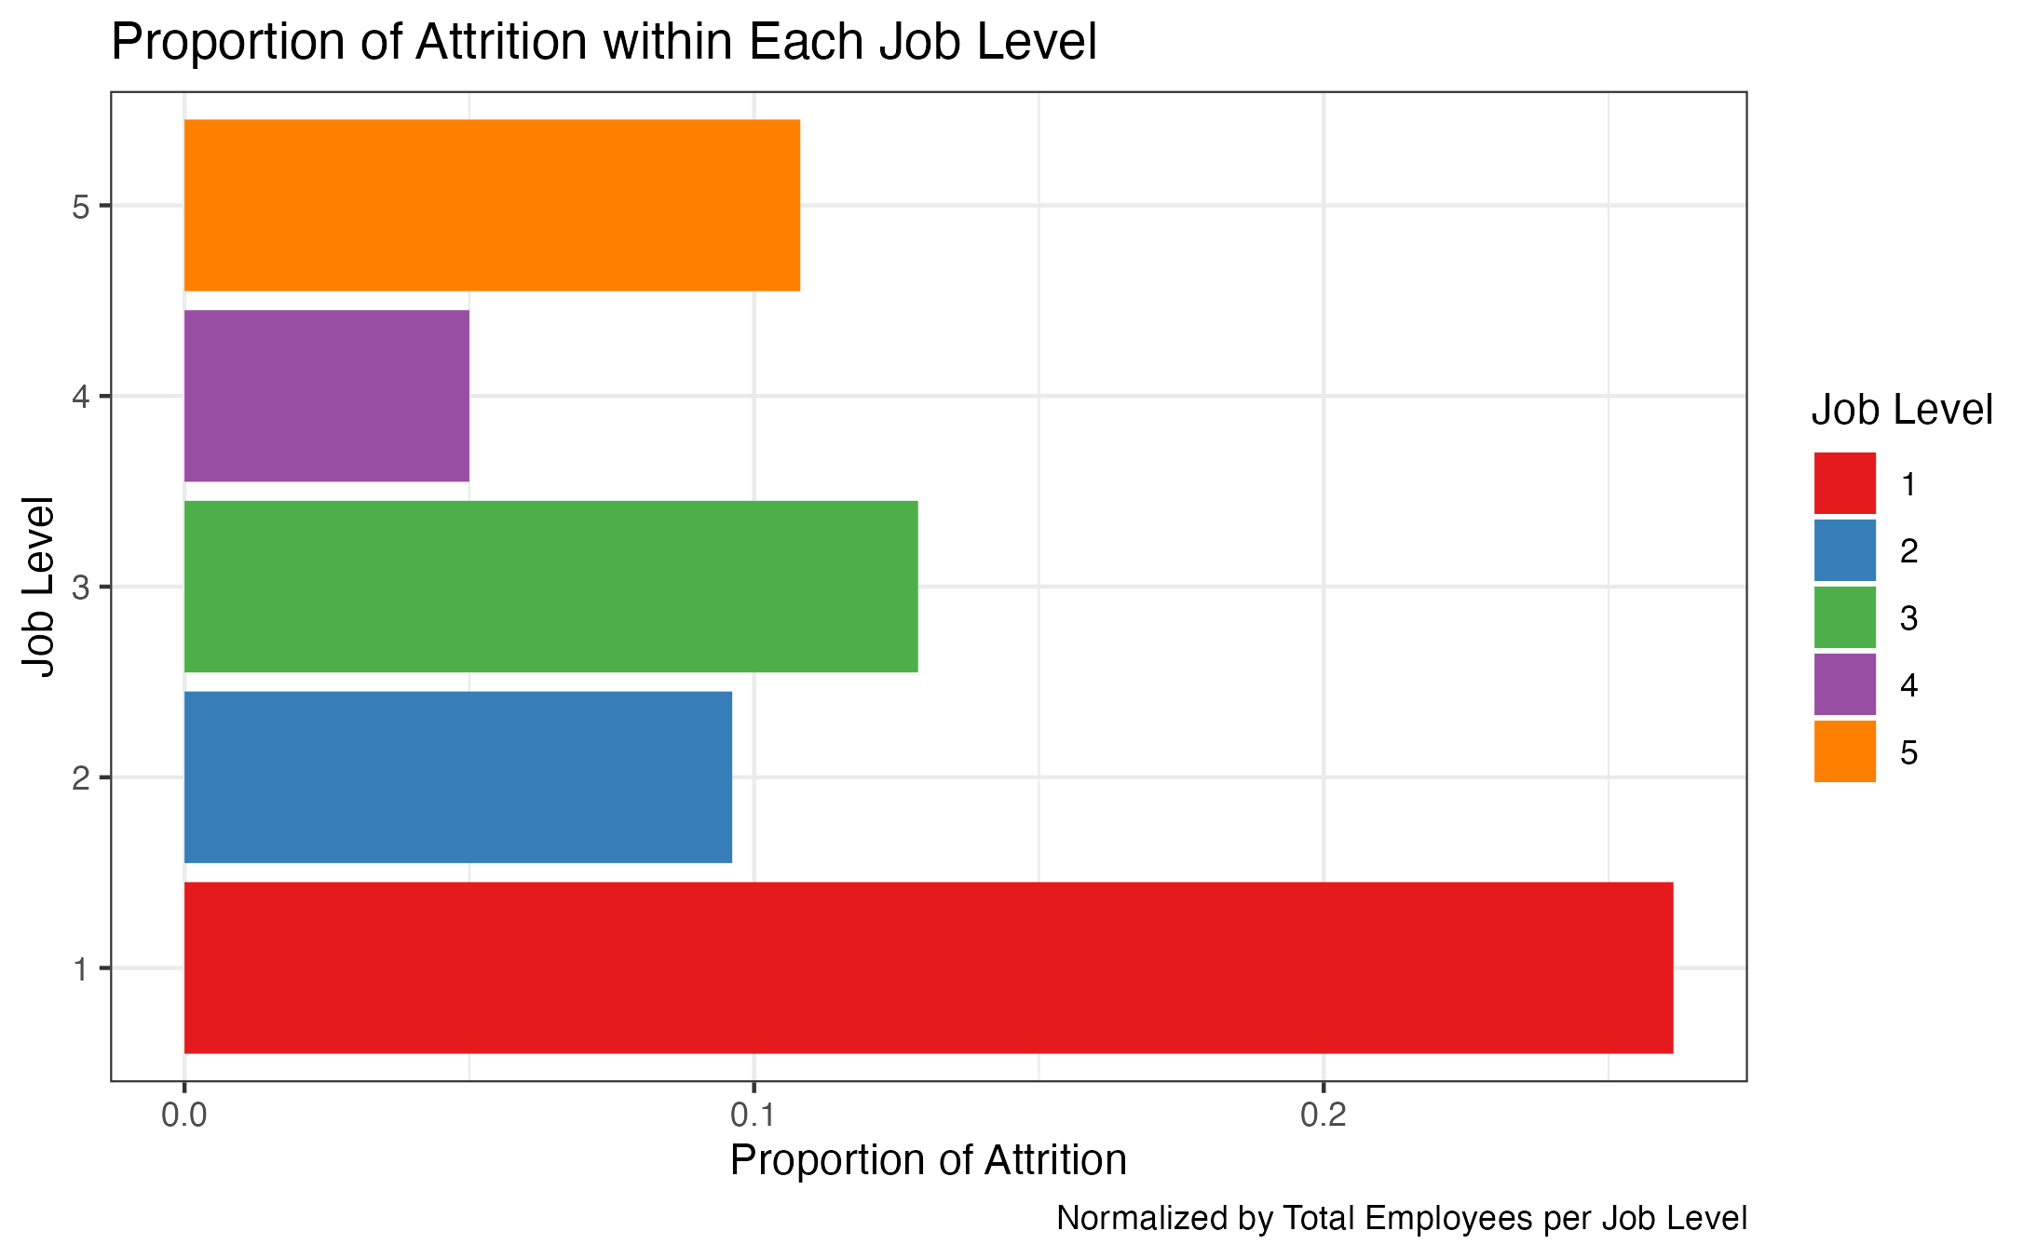
VISUAL EVIDENCE
STATISTICAL EVIDENCE
MODELING
Age
Business Travel
Distance from home
Department
Education Field
Environmental Satisfaction
Job Involvement
Job Level *
Job Role
Job Satisfaction
Marital Status *
Monthly Income *
Number Companies Worked For
Overtime *
Relationship Satisfaction
Stock Option Level
Total Working Years
Work Life Balance
Years At Company
Years In Current Role
Years With Current Manager
Age
Job Involvement
Job Level *
Job Role
Marital Status *
Monthly Income *
Overtime *
Stock Option Level
Total Working Years
Years At Company
Years In Current Role
Years With Current Manager
Job Level *
Monthly Income *
Overtime *
significance level: α = 0.05
achieved highest specificity
Notes:
Started by plotting each variable to compare the attrition groups. Variables listed seemed to show differences in these populations. These four seemed particularly important.
For example, let’s look at the proportion of attrition in each job level. Over a quarter of the employees in job level 1 leave the company. This is an attrition rate at least 13% higher than any other job level.
To illustrate an example of a variable lacking evidence of an association with attrition, we can look at gender. There in almost no difference in attrition rates between males and females.
Next, I ran statistics for each of these 21 variables, checking for evidence of differences between the attrition groups. These list, including again the four starred, had significant differences below the alpha 0.05 level.
From this list, I identified a subset of three variables that achieved the highest specificity when used in a predictive model for attrition. Specificity refers to the percentage of instances where attrition is correctly predicted.
The top 3 factors leading to attrition are Job Level, Monthly Income and Overtime.

Slide 4
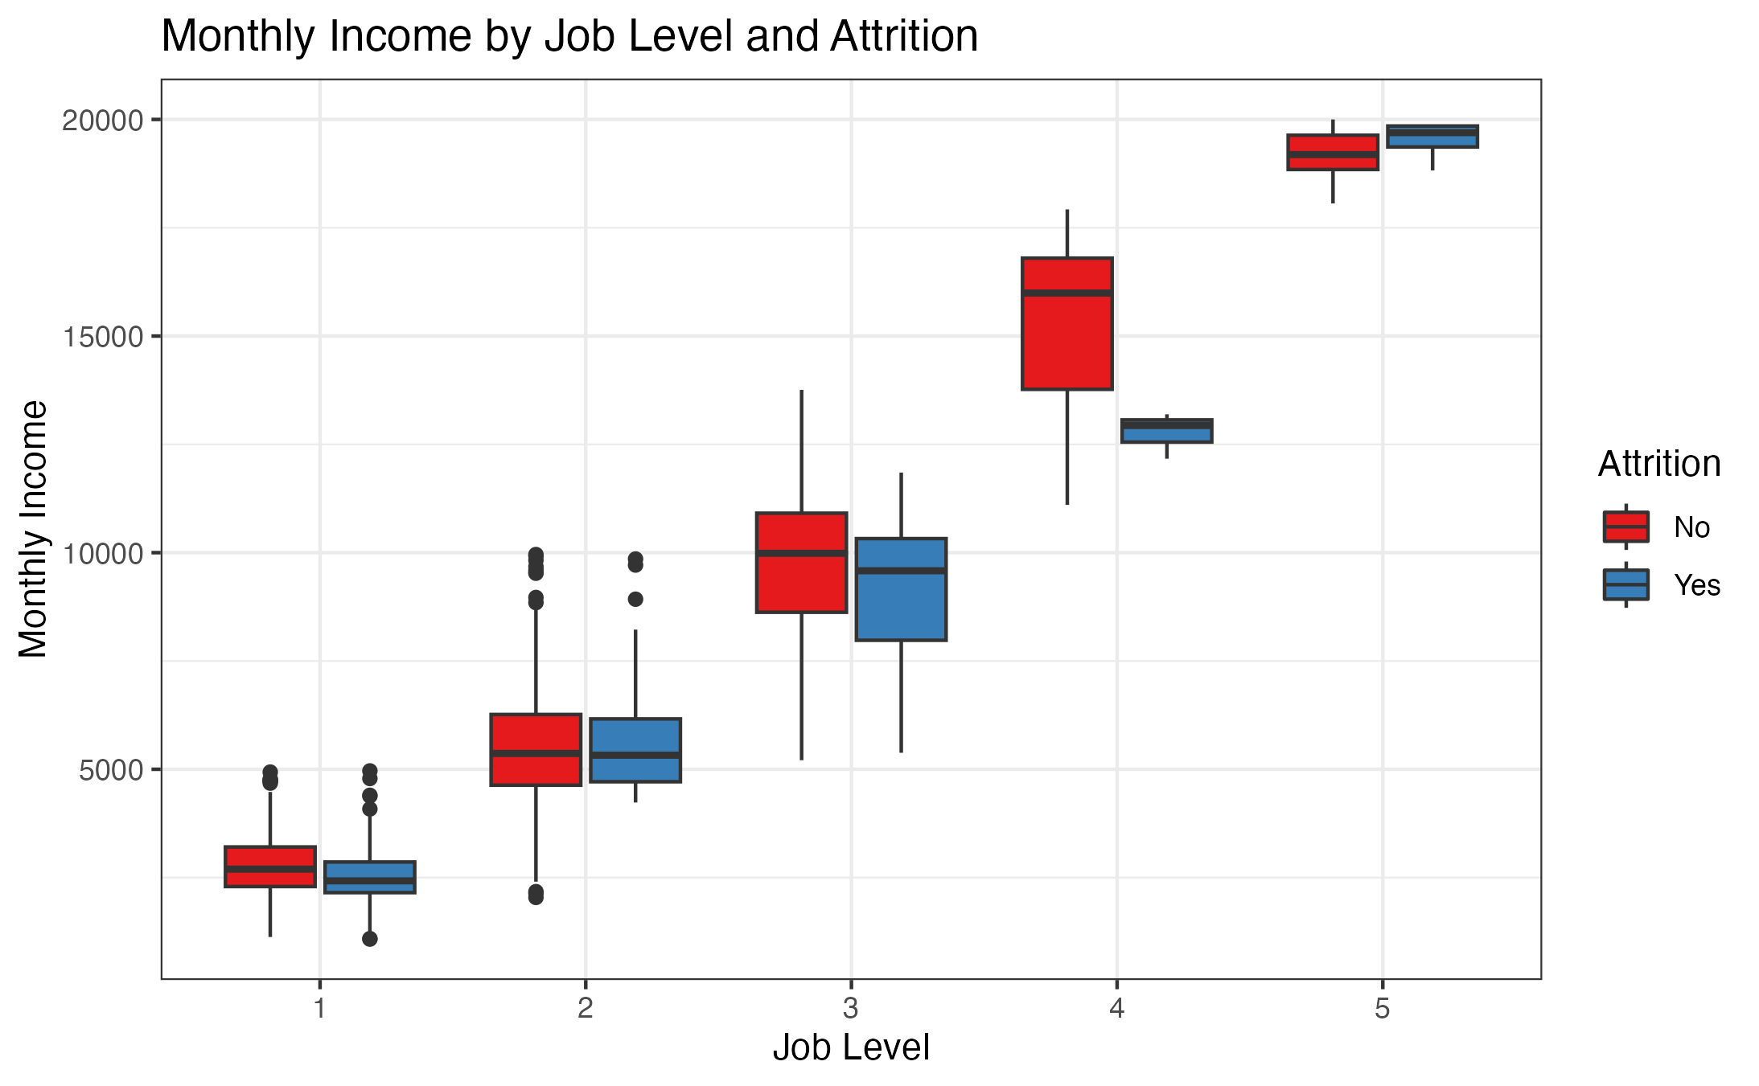
ASSOCIATIONS & ATTRITION TRENDS: Income & Job Level
Positively associated
Strongest trend in job level 4:
Large income gap between those that stay and leave
Job levels 1 & 3:
Also, trend of attrition with lower median incomes
Notes:
This plot illustrates the positive relationship between job levels and income.
It reveals a large income gap between employees that stay and those that leave in job level 4.
Job levels 1 and 3 have a small trend of attrition with lower median incomes.

Slide 5
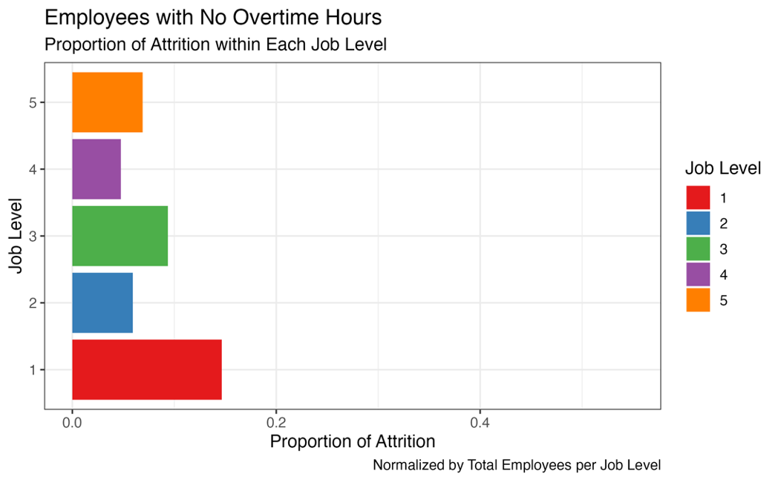
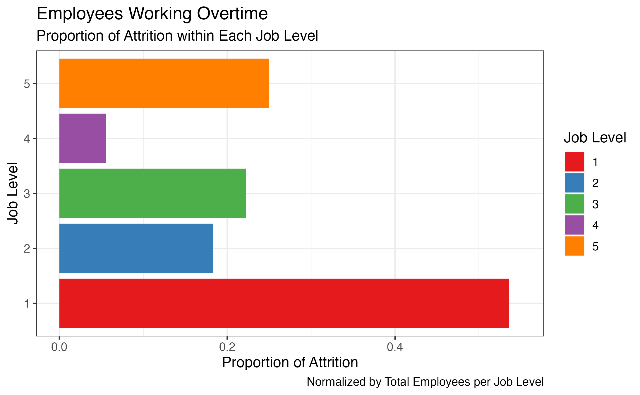
ASSOCIATIONS & ATTRITION TRENDS: Job Level & Overtime
With Overtime
Job level 1:
Attrition rate over 50%
Job levels 2, 3, & 5:
Attrition rates more than double
No Overtime
Low attrition rates
Notes:
Among employees that do NOT work overtime, attrition rates are low, under 15% for job level 1 and under 10% for the others.
However, the story changes for employees working at least an hour of overtime.
Over 50% of employees in job level 1 working overtime choose to leave.
This pattern holds true across all job levels except for job level 4, with attrition rates more than doubling among overtime workers.

Slide 6
ATTRITION MODEL
NAÏVE BAYES
IMPORTANT VARIABLES
K-NN
Business Travel
Distance From Home
Environment Satisfaction
Job Involvement
Job Level
Job Role
Marital Status
Monthly Income
Overtime
Stock Option Level
Total Working Years
Work Life Balance
Years at Company
Years in Current Role
Years with Current Manager
Business Travel
Distance From Home
Environment Satisfaction
Job Involvement
Job Level
Job Role
Marital Status
Monthly Income
Overtime
Stock Option Level
Total Working Years
Work Life Balance
Years at Company
Years in Current Role
Years with Current Manager
Model Evaluation
Sensitivity: 83%
employees that stay
Specificity: 67%
employees that leave
Model Evaluation
Sensitivity + Specificity:
nearly equal to Naïve Bayes
Predictions not model dependent
Notes:
For predicting attrition, this set of variables produced the best model. I used them in a Naïve Bayes model.
The model achieved a sensitivity of 83%, a measure of correctly predicting employees that stay.
The specificity of the model was 67%, which is the percent of correct predictions for employees that leave.
Using all the same variables except job role, I compared the Naïve Bayes to a k-NN model.
The sum of the sensitivity and specificity was nearly equal to the previous model, indicating that the predictions aren’t dependent on the model but on the data.

Slide 7
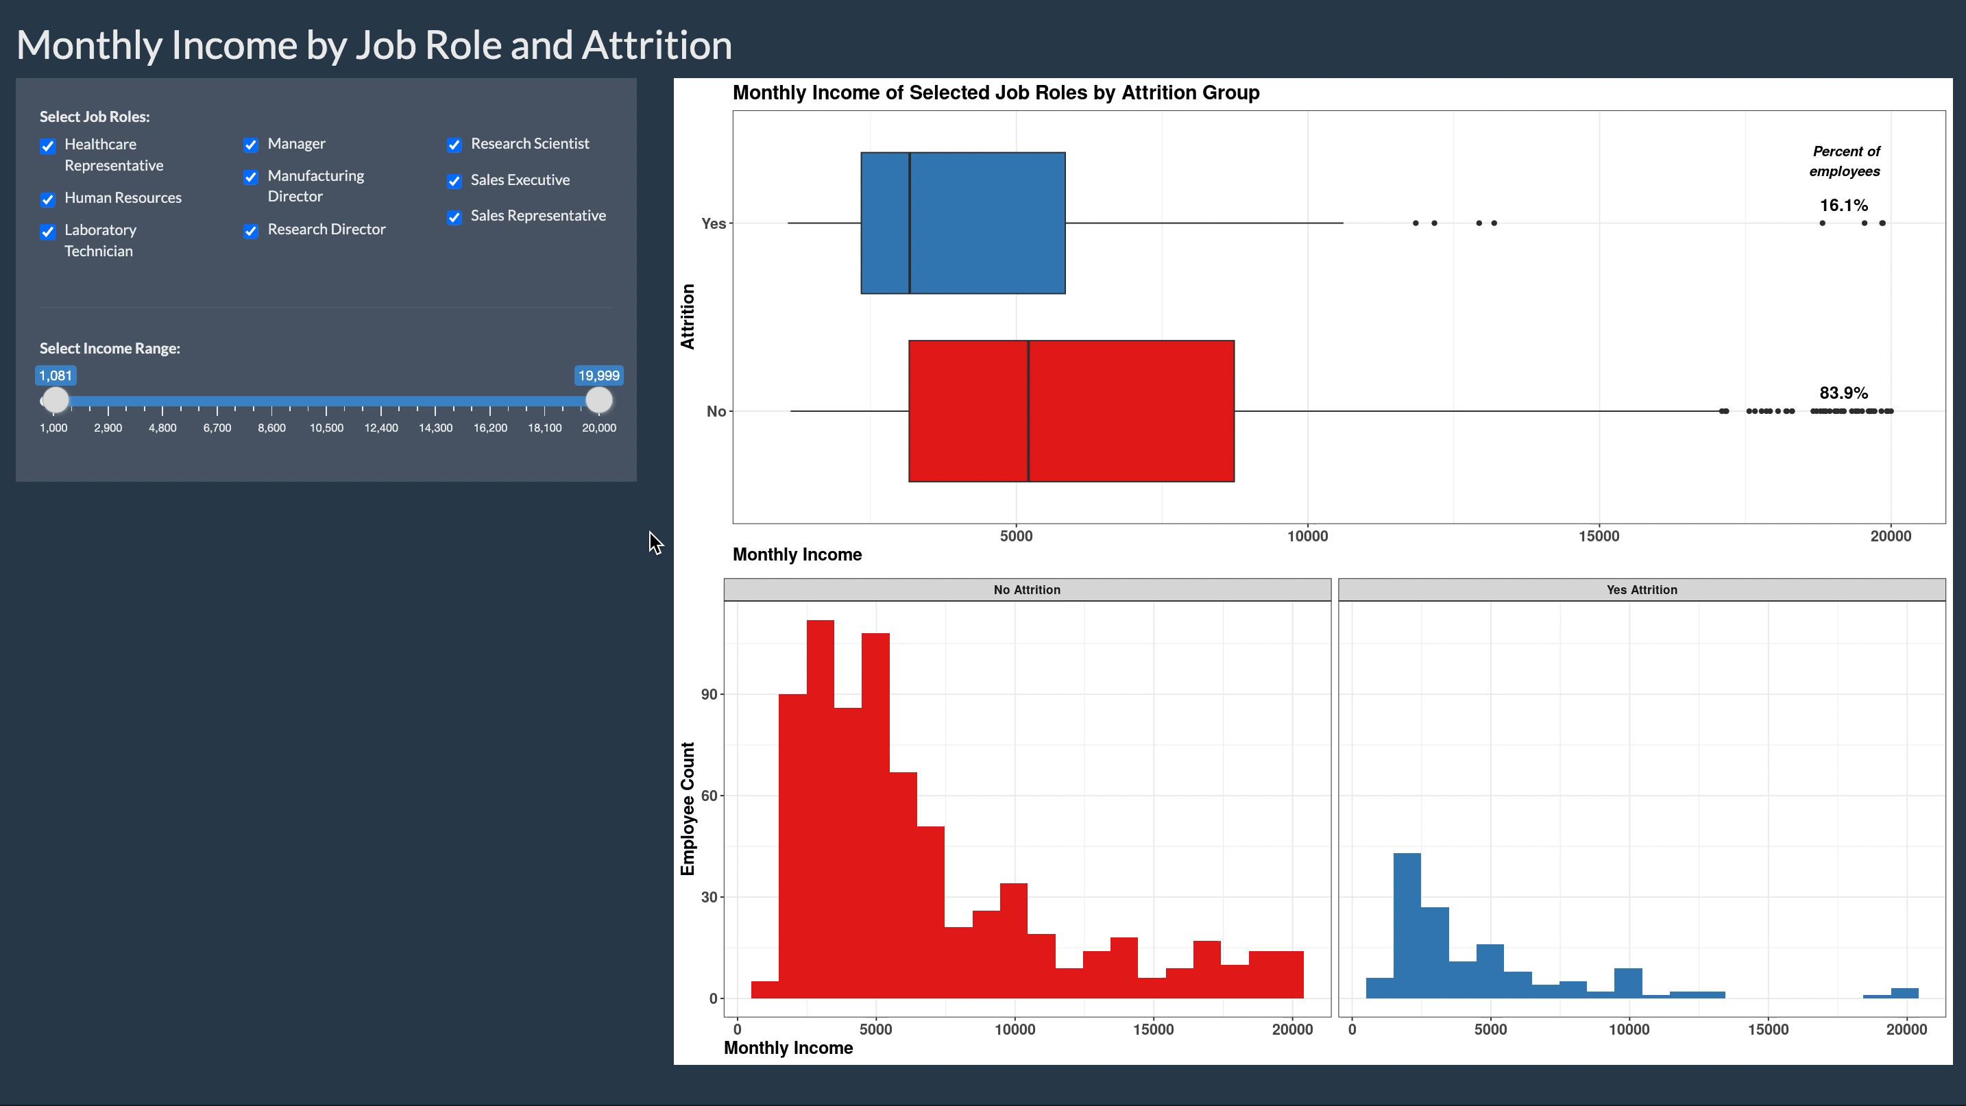
R Shiny Employee Attrition & Income App
Notes:
I’m going to play a short demo of an interactive app I developed.
It displays the distribution of monthly income for each attrition group for any individual or combination of job roles.
You can specify the income range that you are interested in, and as you change the parameters it updates the percent of attrition and the distributions.
I'll provide the link at the end of the talk.

Slide 8
INCOME MODEL
LINEAR REGRESSION
IMPORTANT VARIABLES
Model Evaluation
Root Mean Squared Error (RMSE)
target of 3000
training data: 1357
validation data: 1382
Distance From Home
Environment Satisfaction
Job Involvement
Job Level
Total Working Years
Years with Current Manager
Years with Current Manager²
Notes:
In addition to attrition prediction, I developed a linear regression model for predicting income.
These 7 variables achieve the lowest error rates.
My error metric was root mean squared error or RMSE with a target of less than 3000, the lower the better.
This model achieved an RMSE of 1357 on the training data and 1382 on an independent validation set.

Slide 9
Recommendations for Employee Retention
Job level 4:
increase pay
JOB LEVEL 1, 2, 3, 5:
reduce overtime
Job level 1:
increase pay & promote
Notes:
Based on my analysis, I recommend increasing monthly pay for job level 4 employees earning under 14,000.
For other job levels, reduce overtime.
And for Job level 1 prioritize salary hikes and advancement.

Slide 10
Questions:
Kristin Henderson
hendersonk@smu.edu
THANK YOU!
Data Resources:
https://github.com/kdhenderson/CaseStudy2DDS
Interactive Graph:
https://kdhenderson.shinyapps.io/Employee_Attrition_and_Income_App/
Notes:
If you have any questions, feel free to reach out with the email address provided here. Additional resources and data can be found in the github repository.
The interactive app can be accessed with the bottom link.
Thank you very much for your time.

Slide 11
APPENDIX
ANALYSIS OF
EMPLOYEE ATTRITION
Kristin Henderson
hendersonk@smu.edu

Slide 12
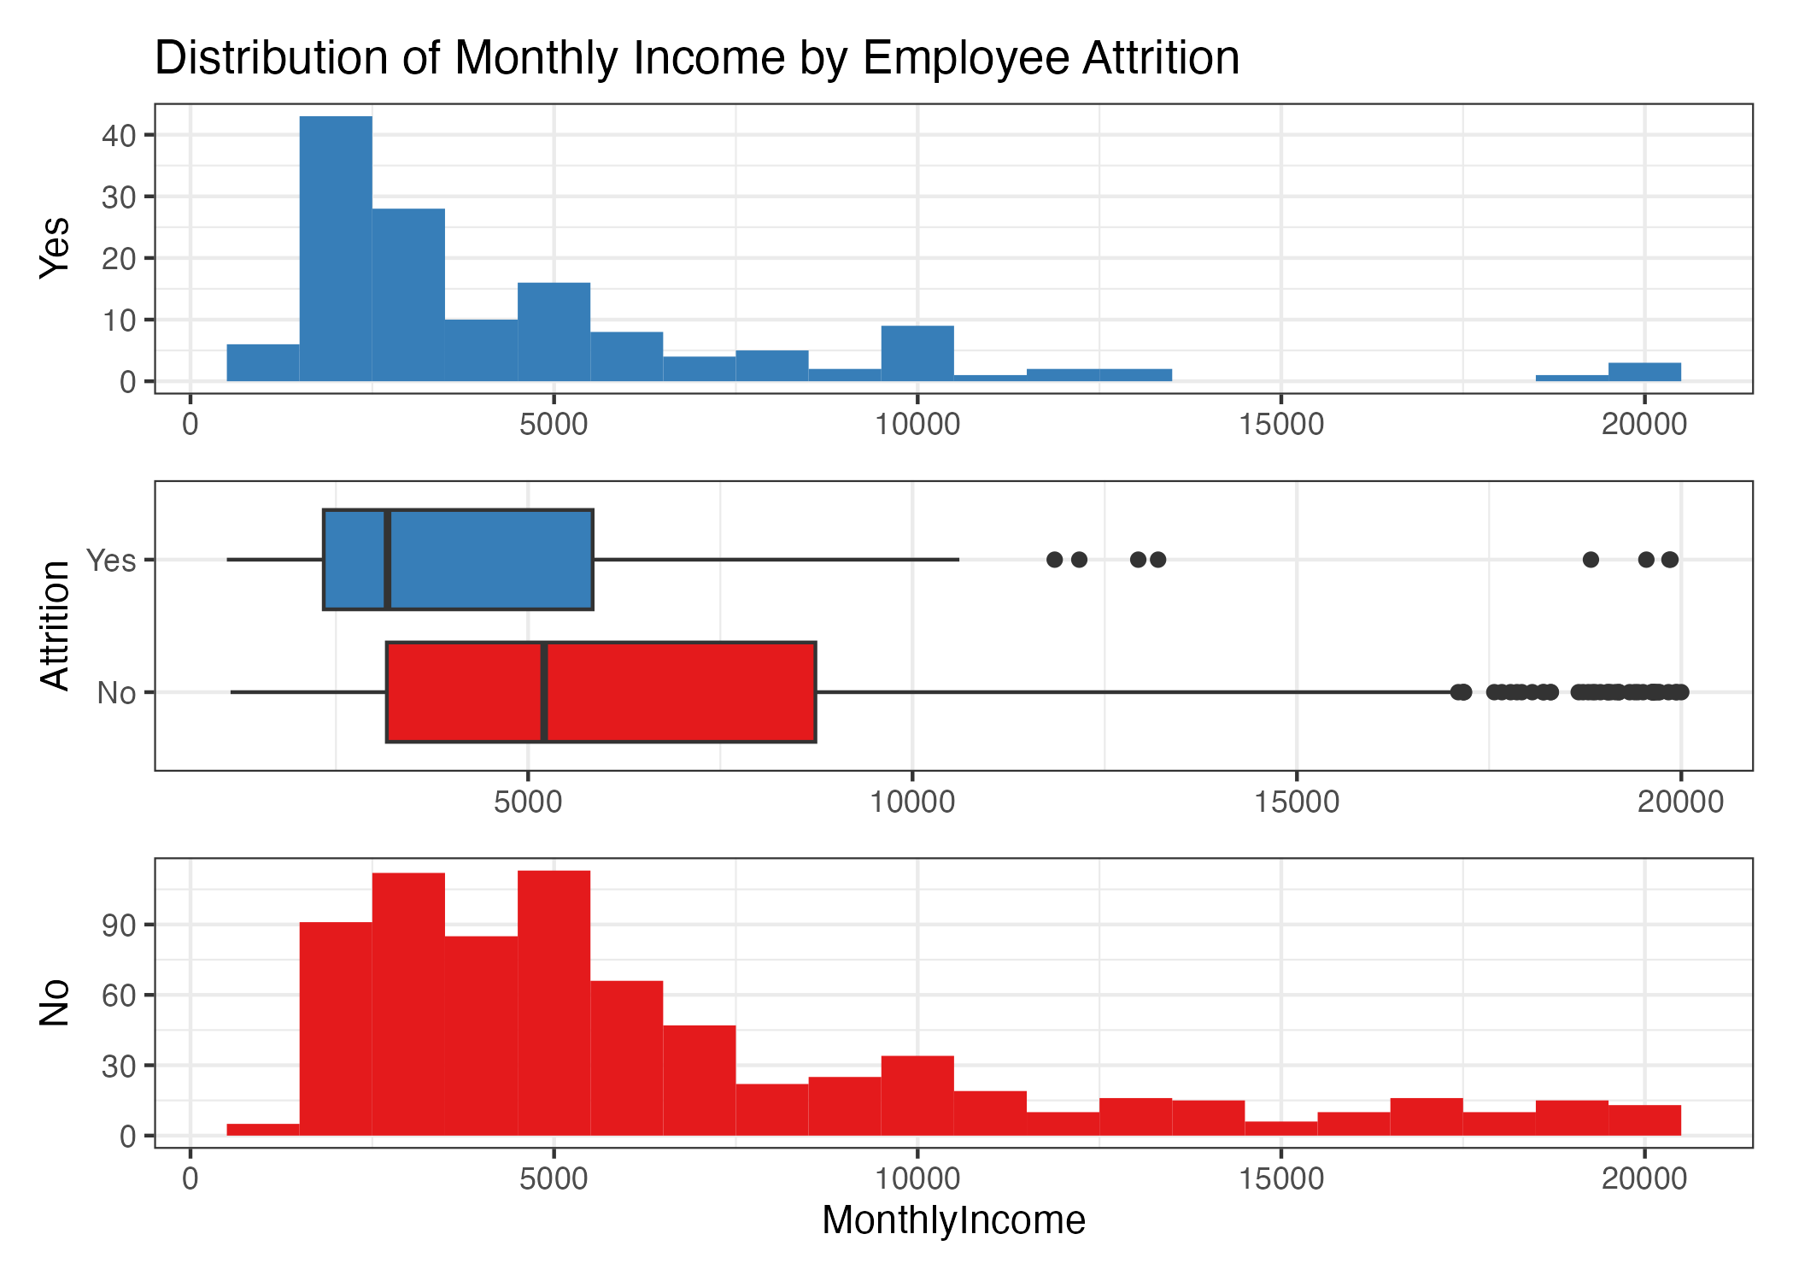
ATTRITION TRENDS: Monthly Income
Income range and median income:
Smaller in the attrition group
High income outliers:
Retirement or factor unique to high level positions

Slide 13
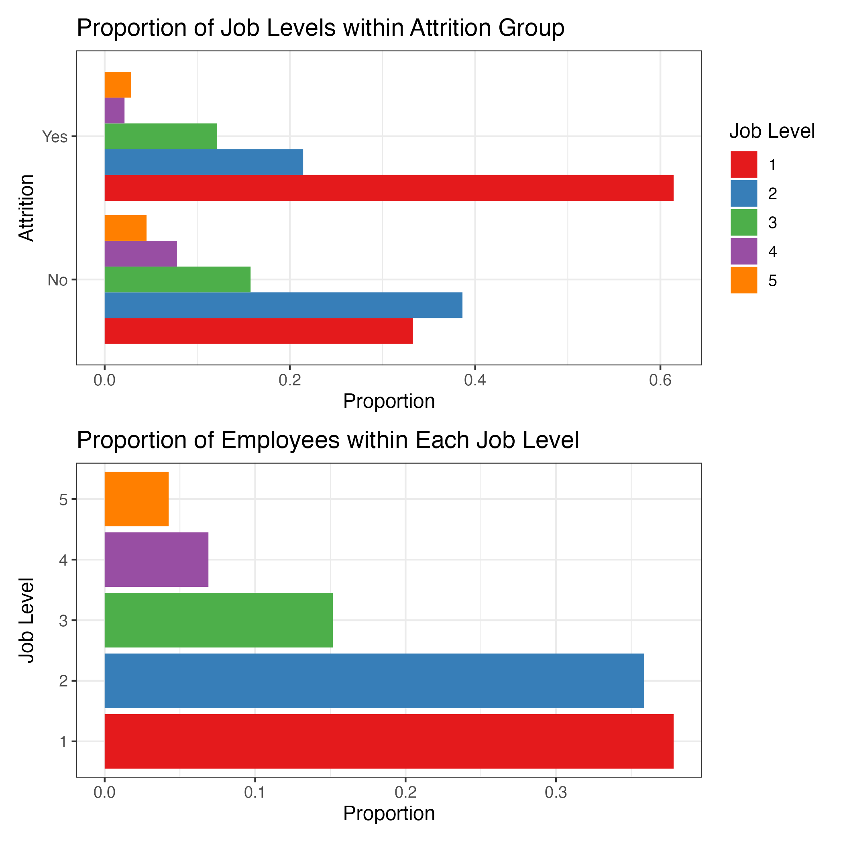
ATTRITION TRENDS: Job Level
Job level 1:
Accounts for over 60% of employees that leave
Overall proportion: < 40%
Notes:
Job level is another predictor of attrition. On the top graph, each job level is plotted separately for the attrition groups and the bottom shows job levels among all employees.
Job level 1 accounts for over 60% of employees that leave, more than 20% higher than the overall proportion of employees in job level 1.

Slide 14
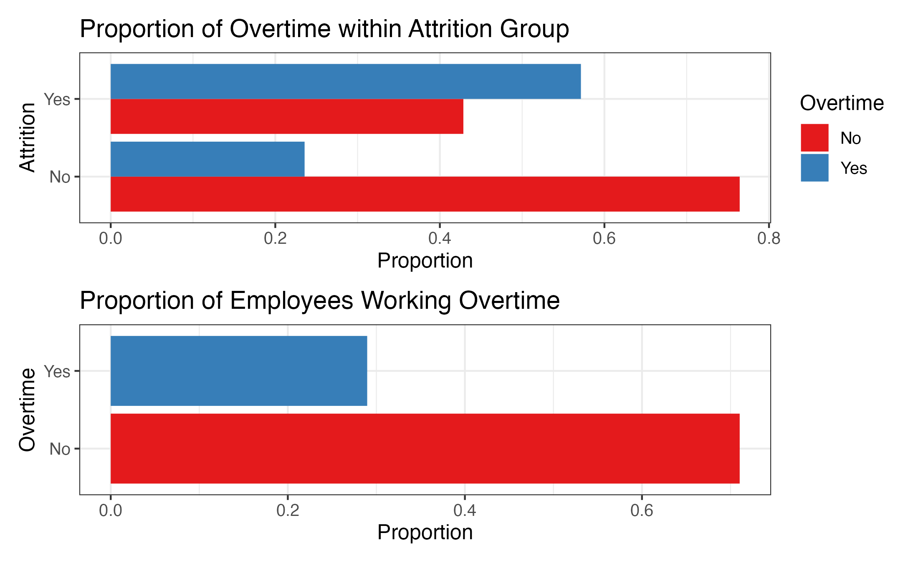
ATTRITION TRENDS: Overtime
Employees that leave:
More than 55% work overtime
Overall proportion: < 30%
Notes:
This is a similar plot displaying overtime, with the proportion of employees working overtime plotted separately for attrition groups on the top and then on the bottom for all employees. Among employees that leave, more than 55% work overtime which is more than 25% higher than the overall proportion of employees working overtime.

Slide 15
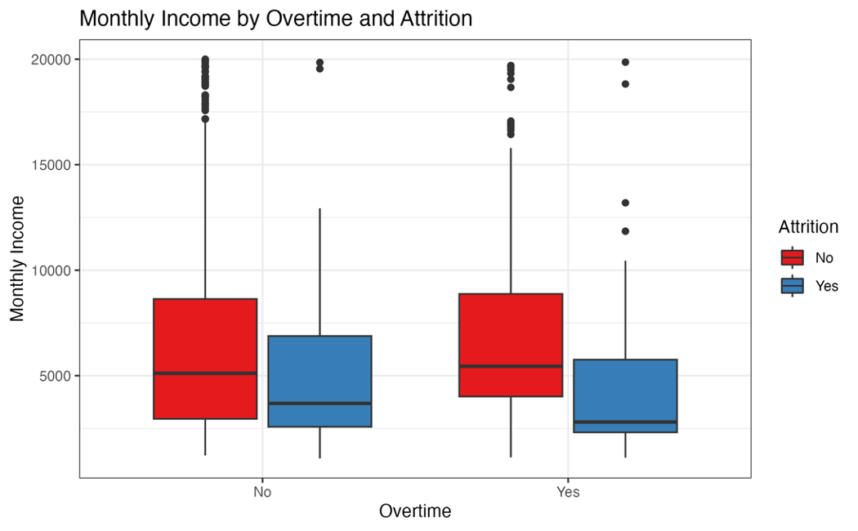
ASSOCIATIONS & ATTRITION TRENDS: Income & Overtime
In employees working overtime:
Larger income gap between attrition groups
Possible indication:
Lower income and overtime make attrition more likely.
Notes:
There is a larger income gap between attrition groups in employees working overtime, indicating a possibility that lower income and overtime make attrition more likely.

Slide 16
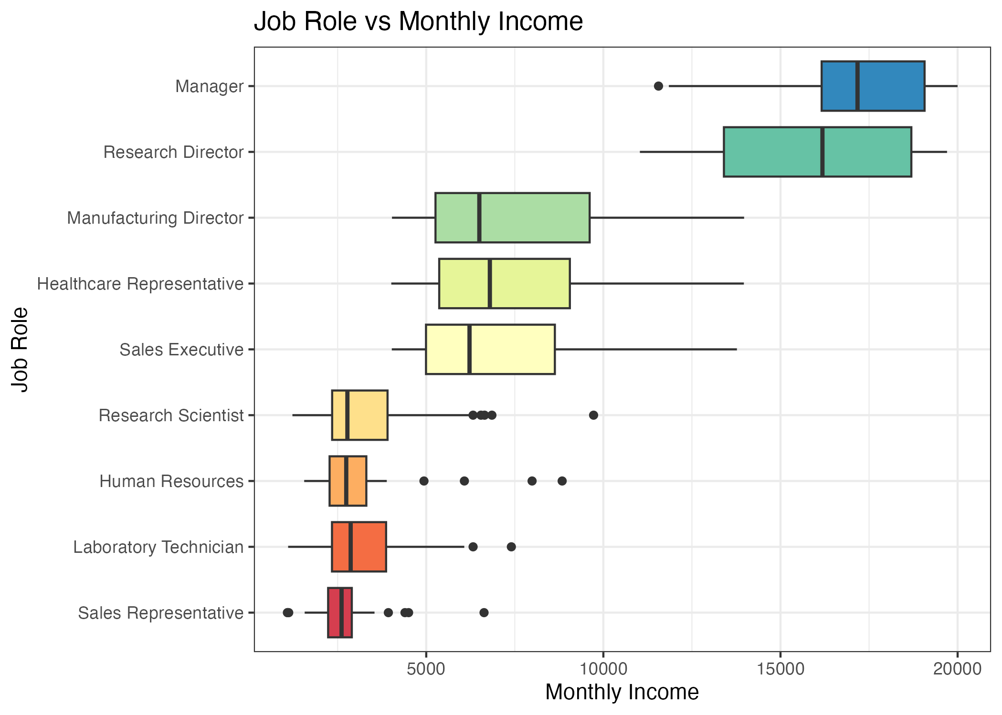
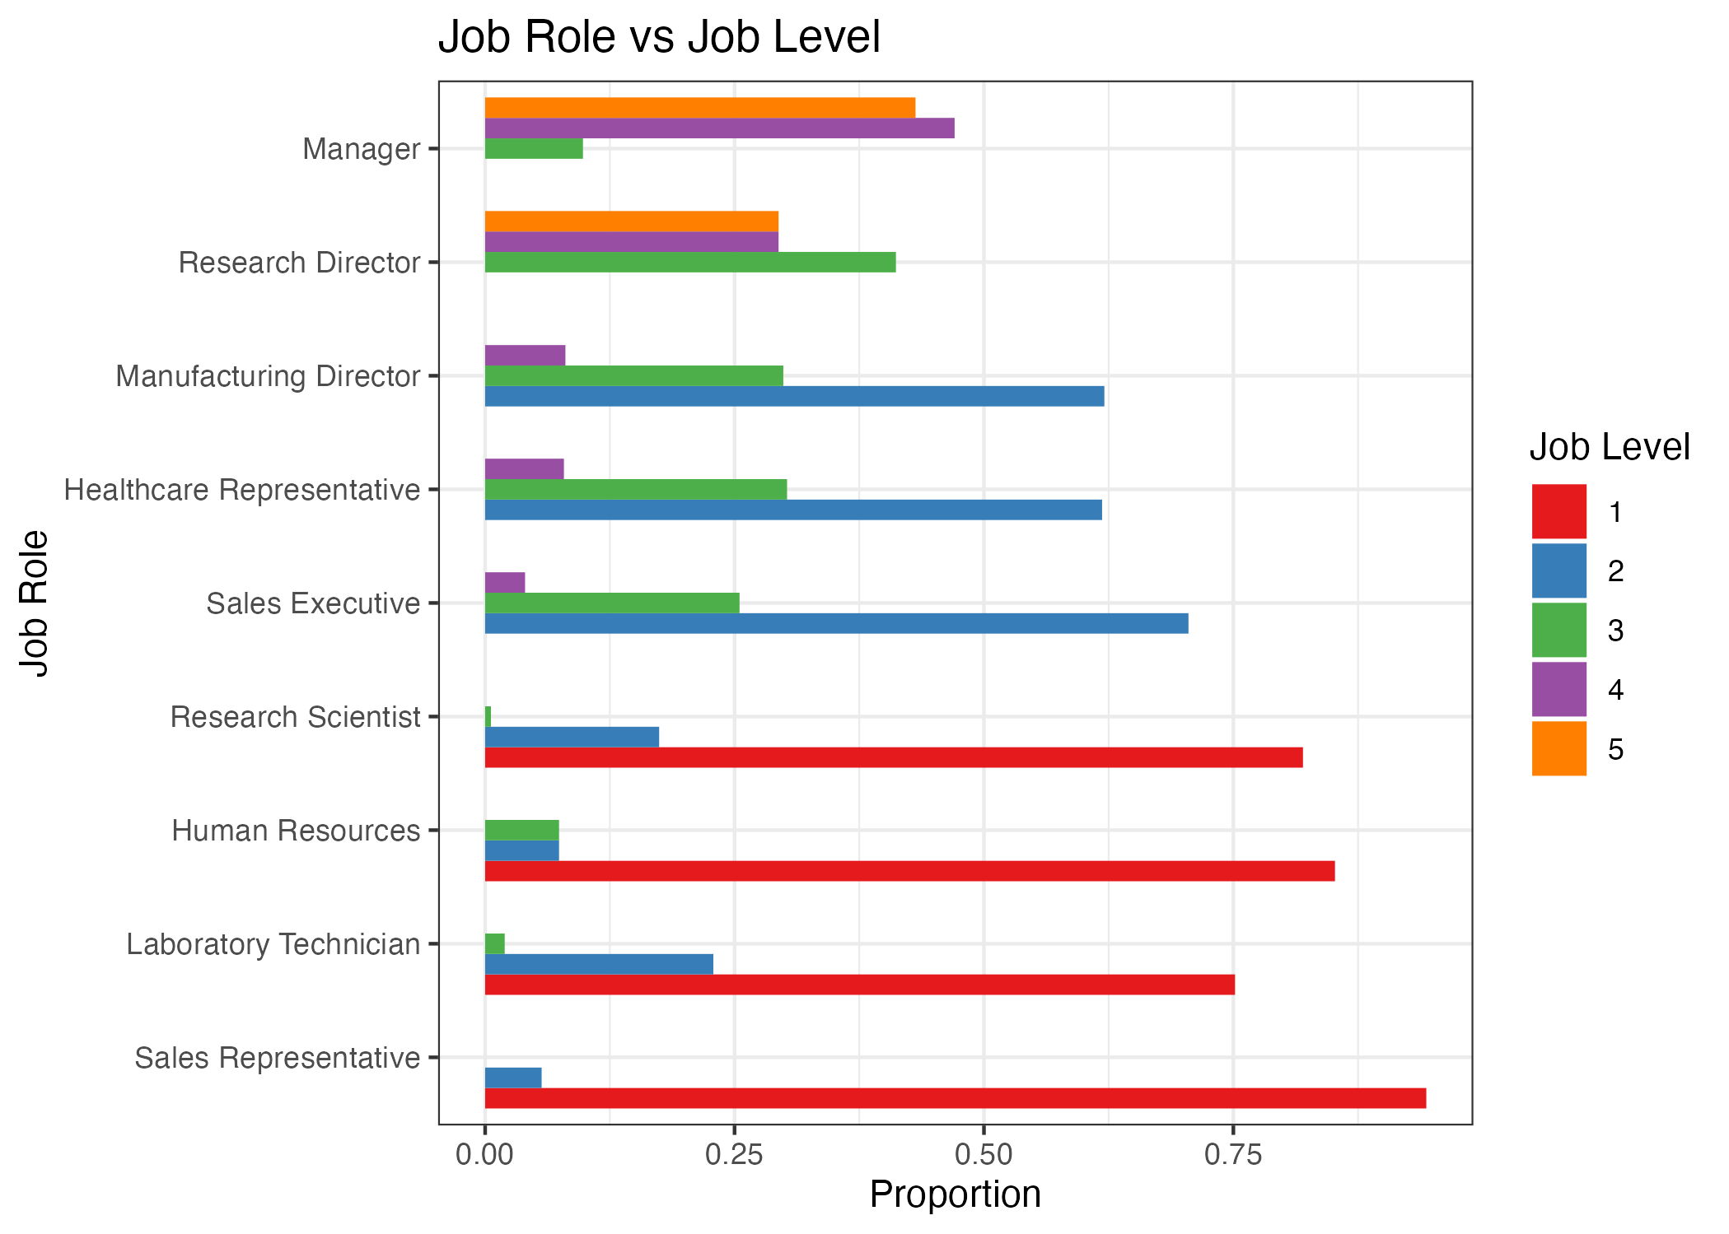
Job Roles segregate into three groups:
Sales Representative | Sales Executive | Research Director
Laboratory Technician | Healthcare Representative | Manager
Human Resources | Manufacturing Director
Research Scientist

Slide 17
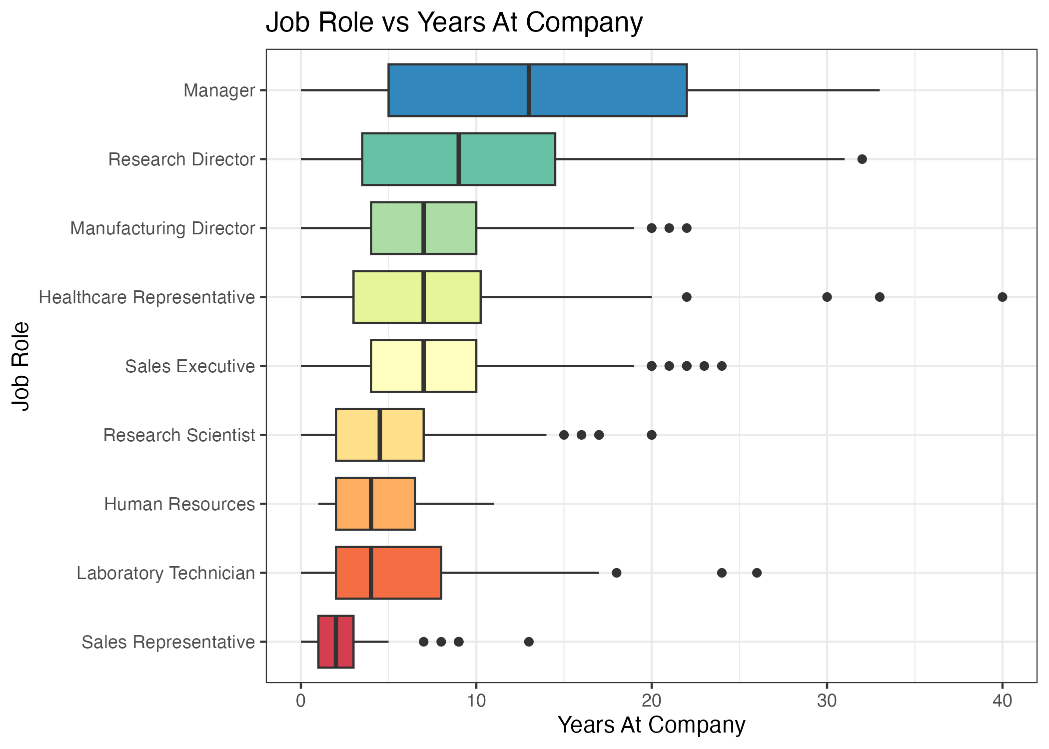
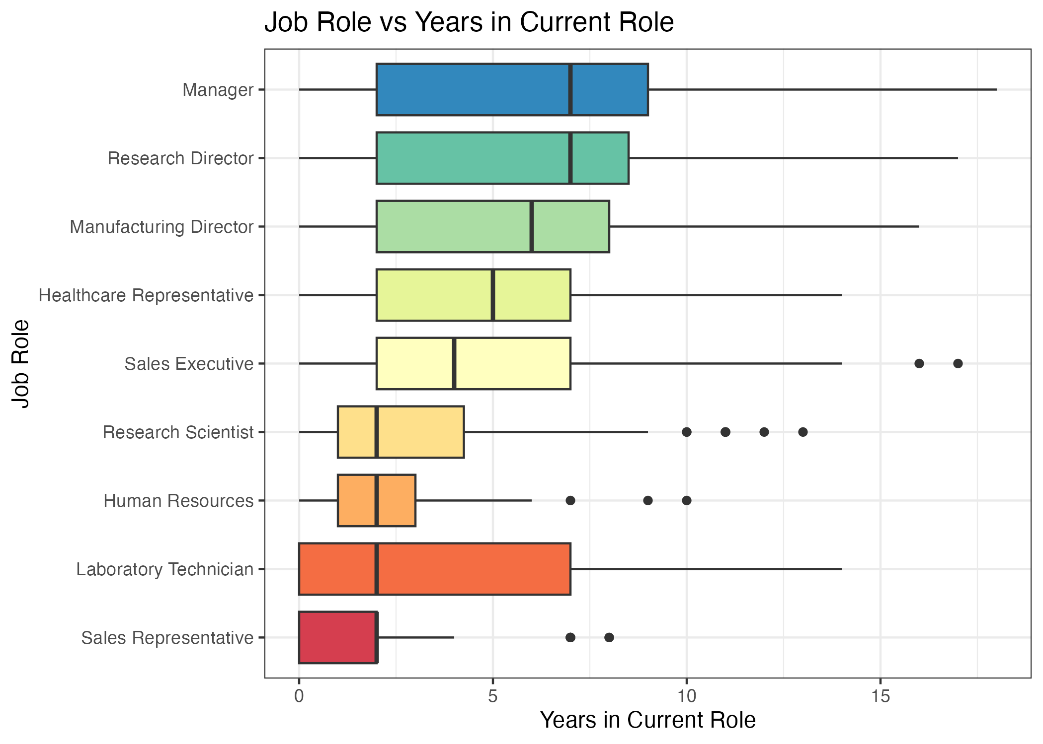
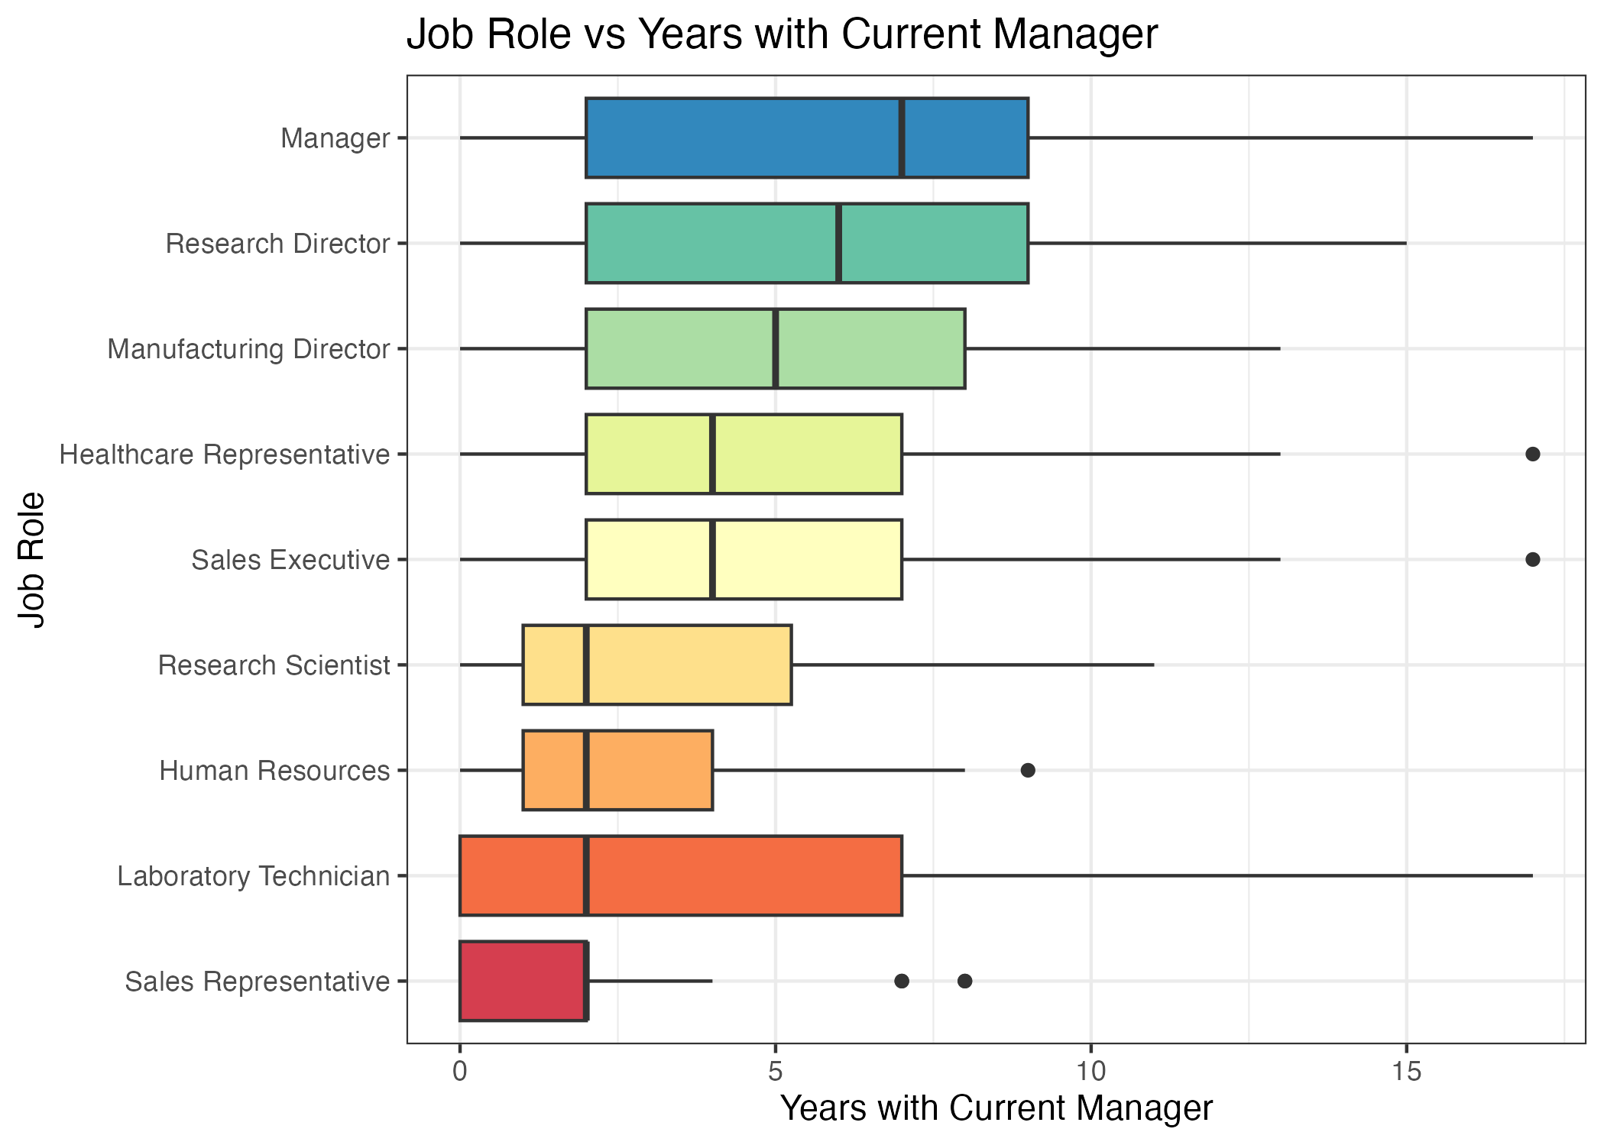
JOB ROLE TRENDS:
Three group trend holds across other factors.

Slide 18
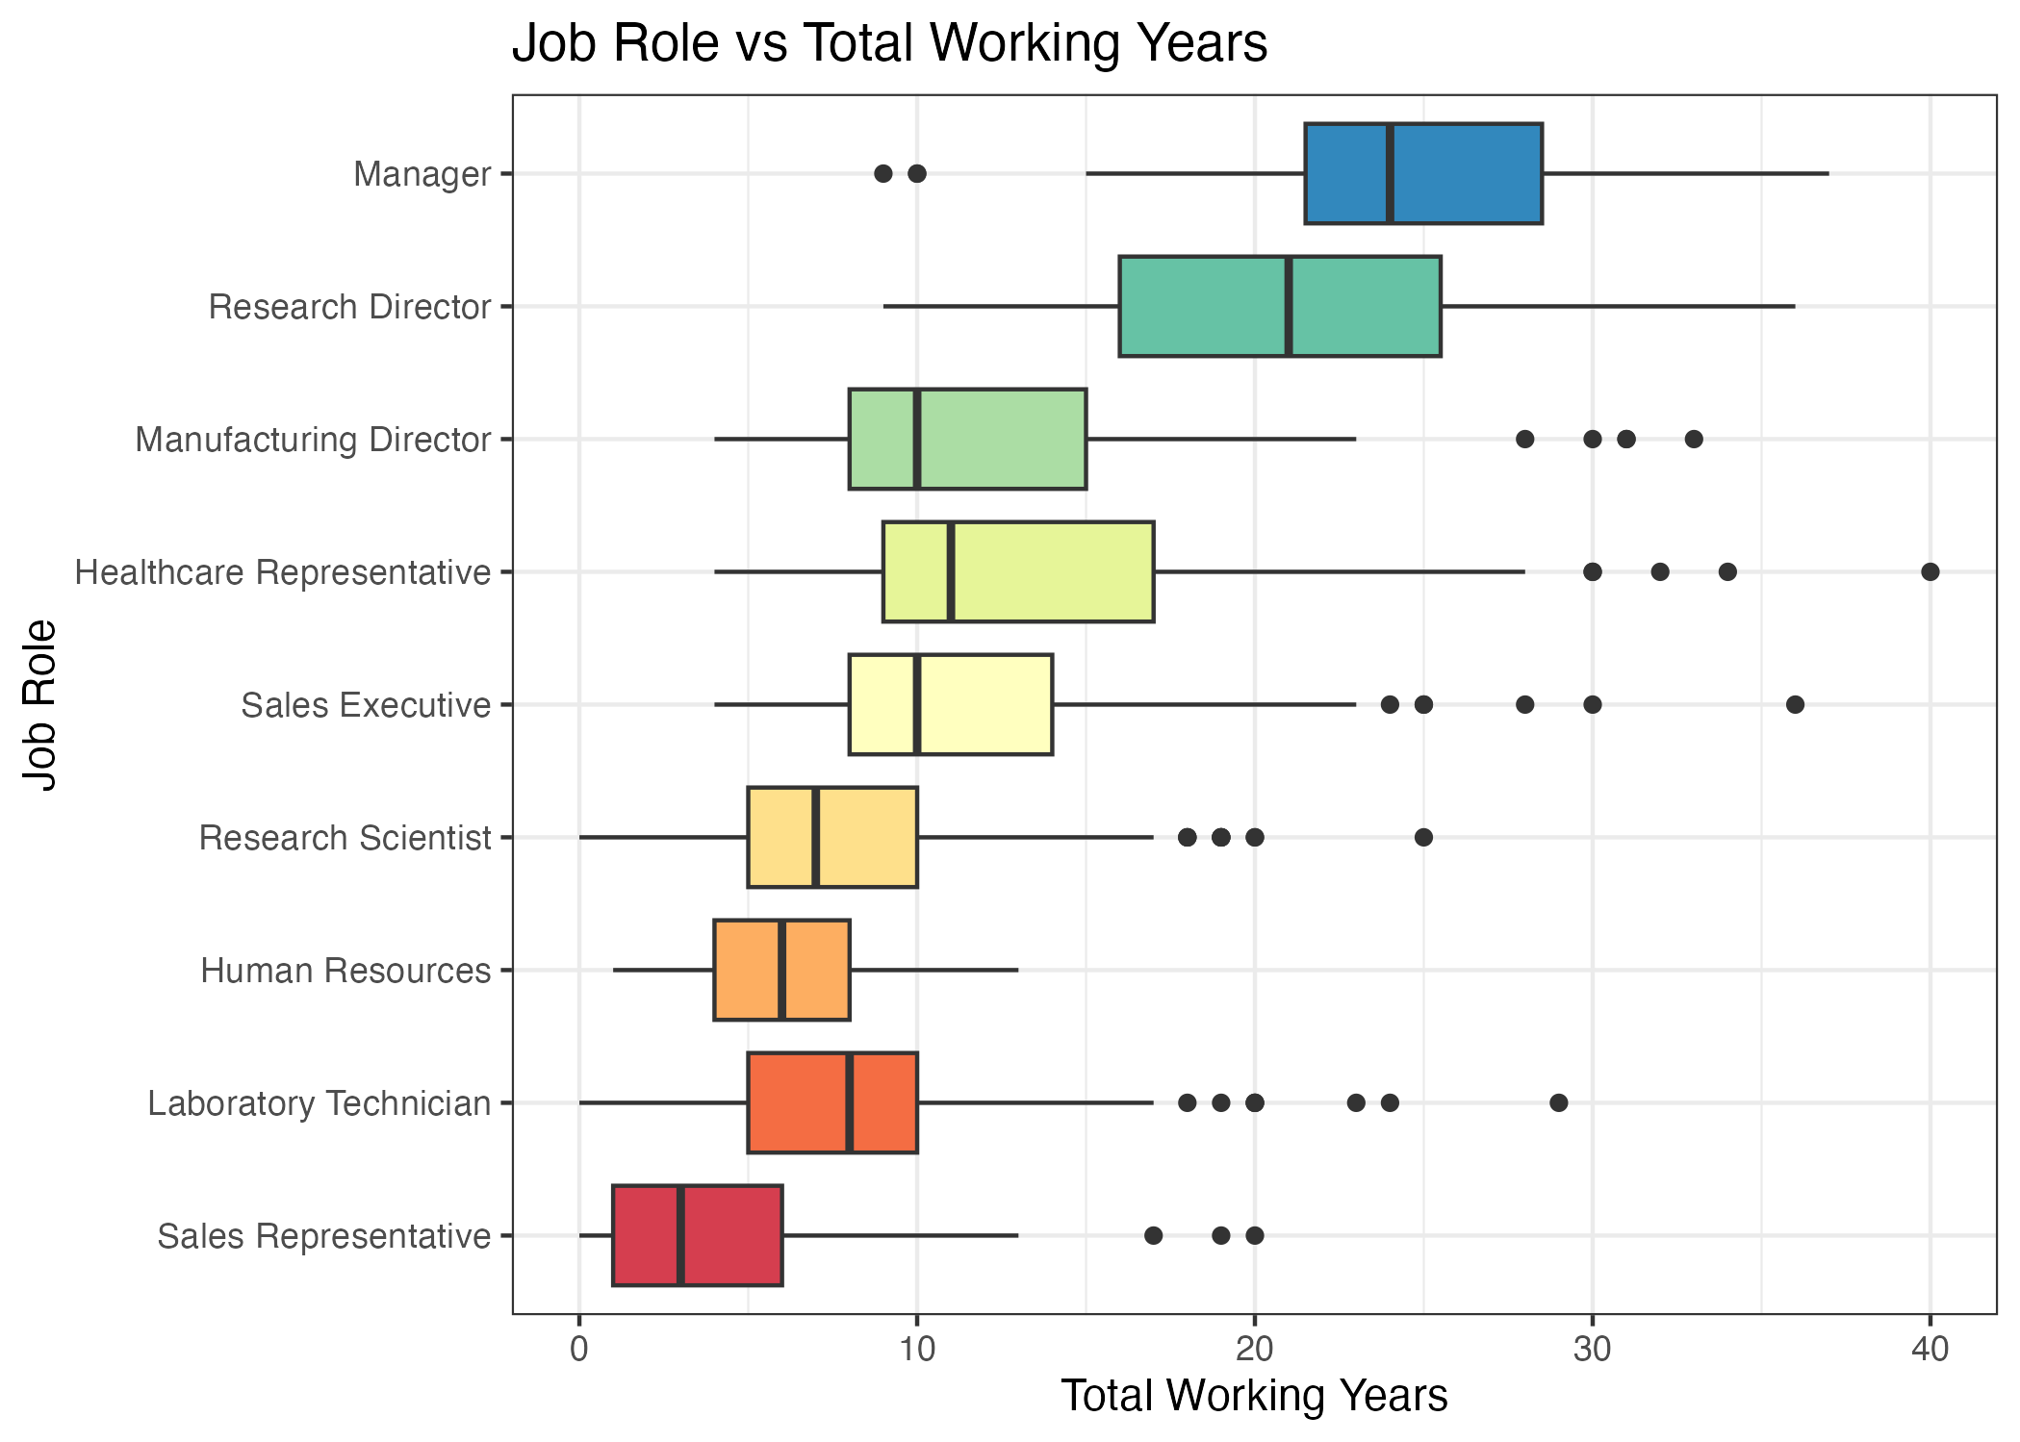
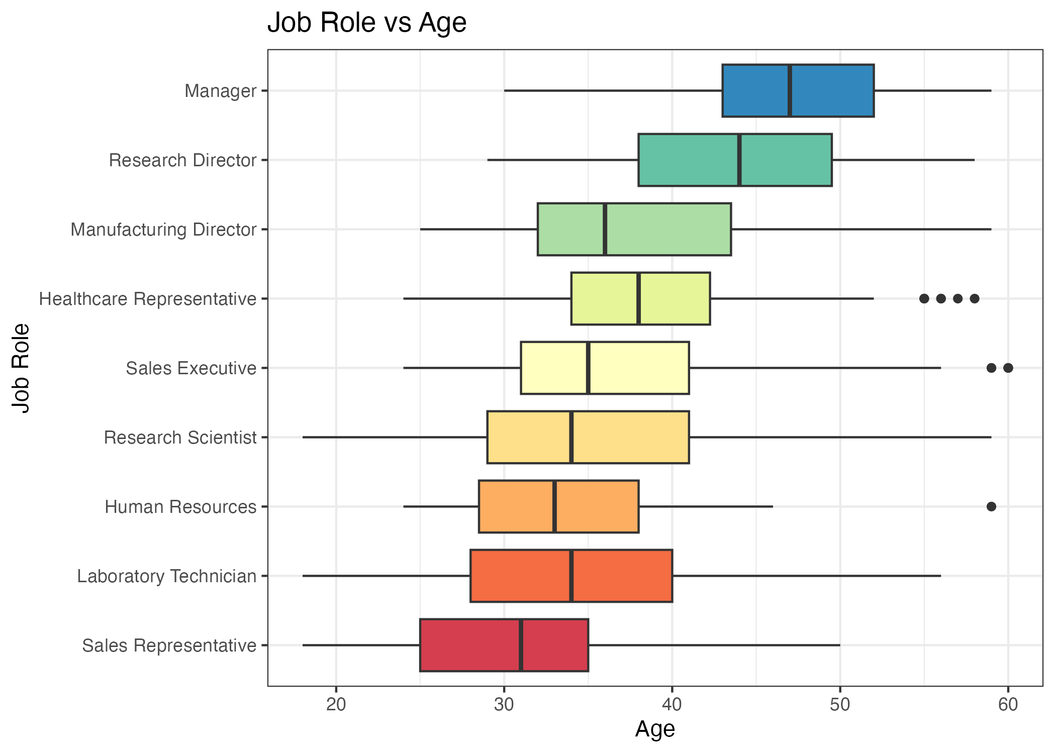
Notes:
If you are interested in how Job Roles may be related to other features of the data, all the plots are in the github repository and the link is at the end of the presentation.

